Slide 1
2nd Kentucky R3 Summit

Slide 2
Notes:
Early Muzzleloader 2014

Slide 3
Reflection on R3: National Level
Notes:
Lets take a moment and reflect on R3 both at a National and State level. First we will focus on national R3 efforts

Slide 4
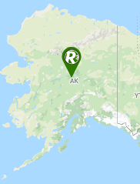
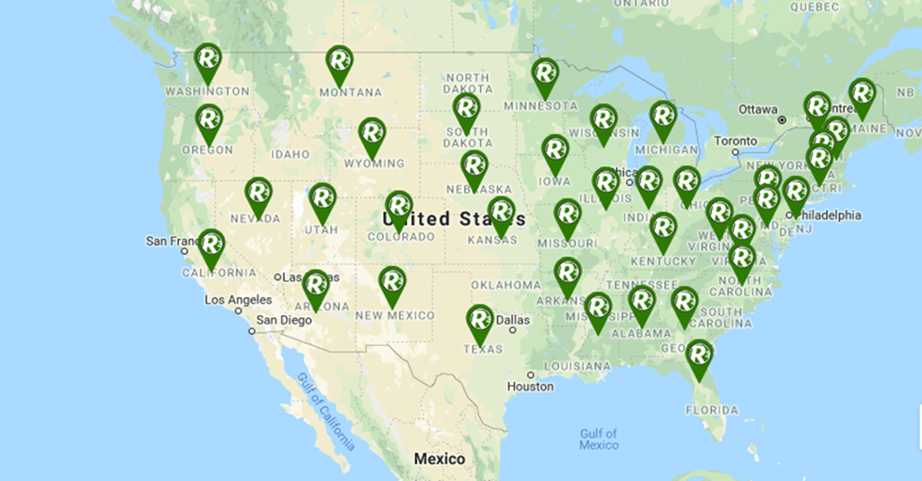
Reflection on R3: National Level
2019
2017
Notes:
In 2017, started with 10-12 coordinators on staff nation wide
In 2019 more than 35-37 states have R3 coordinators or R3 teams working on actively on R3 efforts with their organizations
The Council to Advance Hunting and The Shooting Sports along Wildlife Management Institute is making R3 a priority over the past few years, bringing in state agency, industry leaders, non government organizations. providing new opportunities, new approaches, and strong partnerships!

Slide 5
Reflection on R3-National Level
State Plans
Iowa
Georgia
Virginia
Kentucky
Maine
California
Missouri
Florida
Notes:
Overall there has been 8 states completed a Strategic plan, as well as 12 states working on their plan right now!
Kentucky 1 of 8 States that has completed a strategic plan (1 of 8)
Congratulations to us in being one of the top 10 states EVER in having a R3 Plan!
1,2,3, R3 !

Slide 6
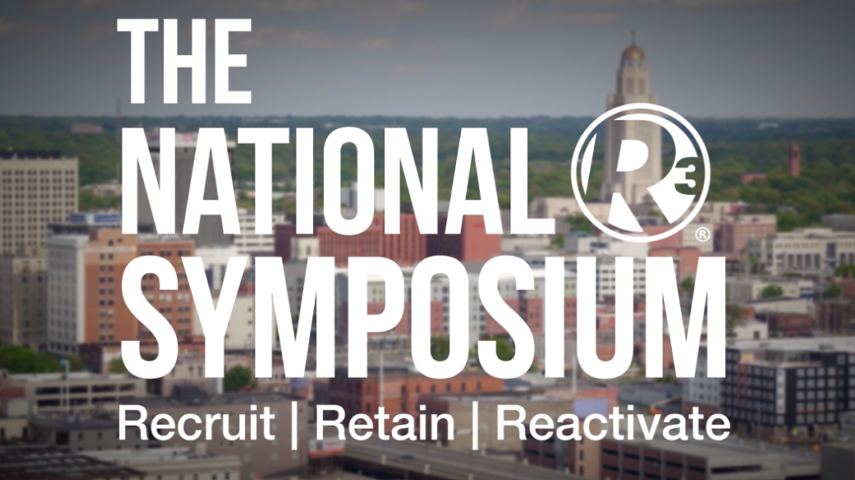
Reflection on R3-National Level
Host 1st 2018 The National R3 Symposium
Upcoming May 2020
USFWS Region 3 Strategic Plan
Midwest
National Implementation Team
Strategic Development of Regional and National R3 Committees
Assessment of National R3 Efforts
Enhanced Partnerships with Angling and Boating Partners
Notes:
The 2018 National R3 Symposium was the first national event solely focused on resources and partnerships needed to secure the future of hunting, angling, target shooting, and boating in America. The event occurred on May, 2018 in Lincoln, NE, a representing more than 40 states and 100 different organizations attracted more than 320 individuals
United Sates Fish and Wildlife Service ; Region 3 R3 Plan of Midwest Region leadership launched the Midwest Region Outdoor Access Initiative. Team members from the Initiative have developed this plan to work with partner to grow the country’s hunting, fishing and outdoor recreation community.
National R3 Implementation workgroup to implement National Plan, Team involves 22 individuals state and federal agency NGO and industry identities and representatives from all regionals of association of fish and wildlife agencies.
A few expected impacts we can see from this group is….
-RBFF, Recreation Boating and Fishing Foundation
- American Sportfish Restoration

Slide 7
Reflection on R3- National Level
R3 Community www.nationalr3plan.com/
Snap Shots
Webinars
What Do You Think? (WDYT)
Modernization of Pittman Robertson Restoration Fund
Notes:
Currently 1,900 current members, anyone can be on the R3 community, engage with post with relevant content to help with discussion. Easy way to stay involved and up to date with R3 nation wide. Provides a platform for communication
New programs and ideas, for industry, NGO and agency to adopt practices and work as a unified team
What do you think?, people come together, challenging questions for people to discuss (WDYT)
Webinars- every 6 weeks to stay involved
PR moderation still ongoing, 3 years This modernization would provide states the ability to utilized PR for hunter and recreational shooter R3 efforts in marketing of educational programs to nontraditional audience.

Slide 8
Reflection on R3: State Level
Notes:
With limited time, we will doing a brief overview of State Updates of R3. From creation of new programs and new partners, R3 has been on fire here in Kentucky. Here is a quick recap of R3 in Kentucky.

Slide 9
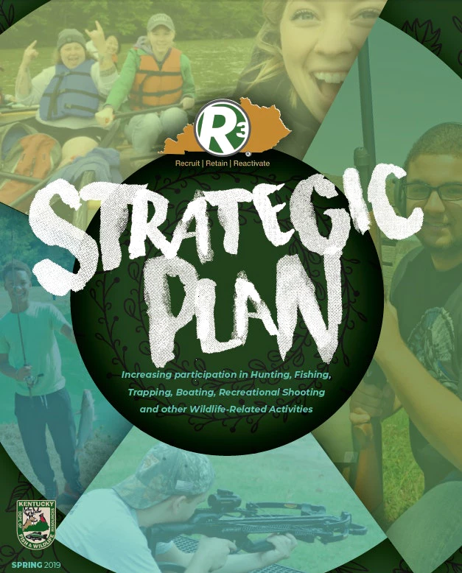
Reflection on R3- State Level
4 Committees Established
April 2017
Completion of R3 Plan
- March 2019
Notes:
With limited time, we will doing a brief overview of State Updates of R3. From creation of new programs and new partners, R3 has been on fire here in Kentucky. Here is a quick recap of R3 in Kentucky.
Again huge thank you, partners, for providing input
Becky will be going through a brief overview of the plan here soon.
Introduce Andrew Wooldridge Conservation Educat

Slide 10
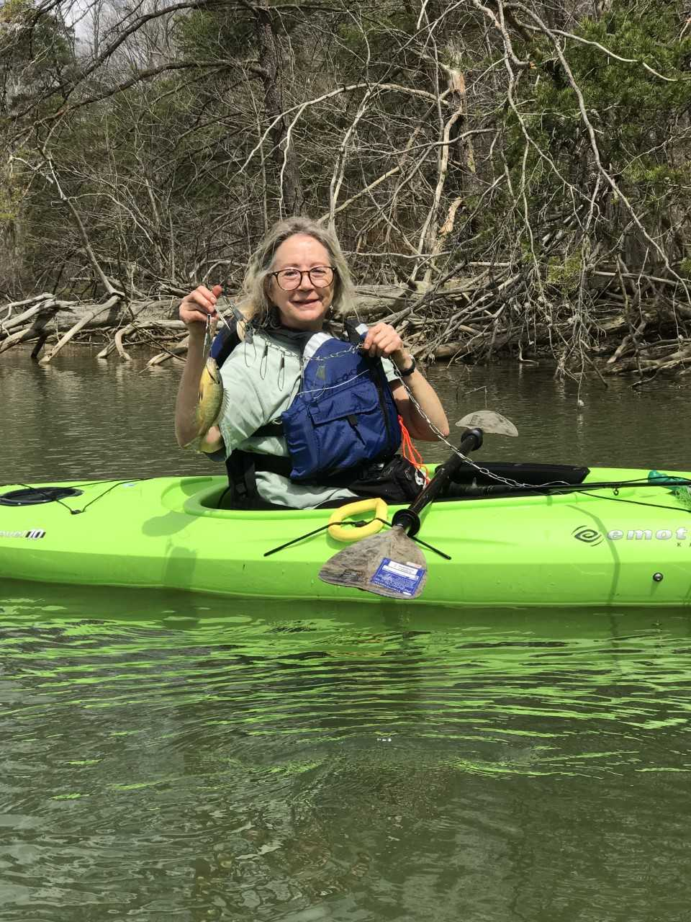
Kayak Fishing (B.O.W and Aquatic Education)
Kayak Numbers- 86
B.O.W Numbers- 57
Kentucky Fish and Wildlife Foundation/League of Kentucky Sportsmen -lifejackets
Notes:
Fleet of 12 kayaks/trailers
Kayak Fishing 101 is a comprehensive beginner fishing and kayaking course that encompasses both classroom and practical portions. This program is specifically designed around the concepts of the R3 Model. In this case, we are focused on all three aspects of the Model. This program attempts to answer the “what next” question for people who previously participated in recreational boating and/or fishing. The classroom portion covers basic concepts including, but not limited to: kayak safety, types of lifejackets, types of watercraft and their features, paddle techniques, navigation of lotic water systems, boat ramp and waterway etiquette, fish identification, biology, fish habitat, equipment, conservation, improving water quality, licensing and regulations.
Despite kayaking being the fastest growing outdoor activity, only 35% of recreational paddlers fish (White et al). This course targets the large segment of kayakers who are already spending time on the water who could easily pick up fishing.
Kayak fishing events started in Fall of 2017

Slide 11
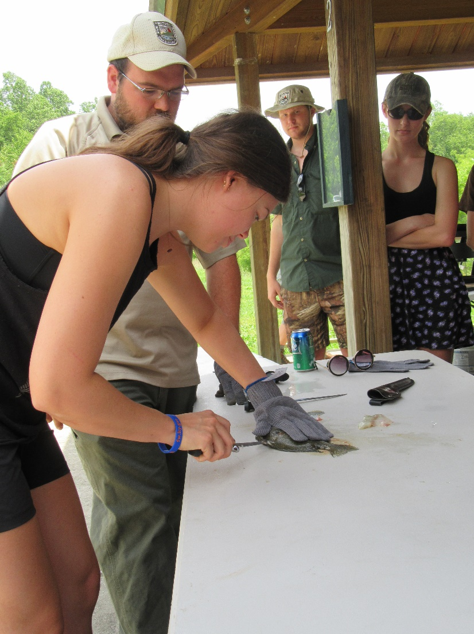
Teachers Tackle Box
Create volunteer instructor trainings
Empower and equip
Provide all equipment needed
Reduce man hours on kids events
Reach more people
Western Kentucky University - 10 adults
Eastern Kentucky University - 10 adults
Morehead State University – 13 adults
Boy Scout Parents- 11 adults
Notes:
d. Teachers Tackle Box is a comprehensive instructional fishing course that encompasses both classroom and practical portions. The goal of this program is to create volunteer instructors and empower and equip them to conduct their own angling programs. This program is specifically designed around the concepts of the R3 Model. In this case, we are focused on retention of young adults who have expressed interest in sharing their passion for the resource. The classroom portion covers basic concepts including, but not limited to: fish identification, biology, fish habitat, equipment, conservation, improving water quality, licensing and regulations, obtaining instructional control, public speaking skills, conflict resolution, alternative educational activities, developing age appropriate curriculum, and locating and recruiting volunteers. The practical portion includes, but is not limited to: location selection, target areas, casting techniques, knot tying, both artificial and live bait selection, how to bait a hook, hook removal, safety, when to fish (time of day/time of year), and gaining familiarity of instructional materials provided by KDFWR.

Slide 12
Annual Report Numbers-Aquatic Education
Year | Type of program | # of programs | Participant #s
2014/2015 | Kids Events | Zero adult | 0
2015/2016 | Hook and Cook | 1 | 14
 | Teachers Tackle Box | 2 | 13
 | Fish Cleaning | 1 | 6
 | Anglers legacy | 12 | 47
 | B.O.W | 2 | 294
Total |  |  | 374
2016/2017 | Hook and Cook | 5 | 55
 | Kayak Fishing 101 | 3 | 86
 | Teachers Tackle Box | 5 | 31
 | Anglers legacy | 15 | 201
 | Fishing Derby | 1 | 40
 | Bow Fishing | 1 | 15
 | B.O.W | 2 | 74
Total |  |  | 502

Slide 13
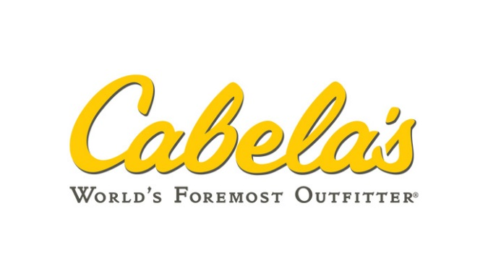
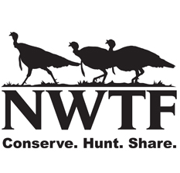
Reflection on R3- State Level
Multistate Grant- University of Kentucky
- AFWA targeting college students
Cabela’s and Bass Pro primary supporter
NWTF
- Western KY land access
S3DA tournaments
Hunter Education
Provide pathway
Notes:
The Kentucky Department of Fish and Wildlife Resources and the University of Kentucky are collaborating on a project made possible by the Association of Fish and Wildlife Agencies (AFWA) Multistate Conservation Grant Program. The project titled, “Evaluating the Promise and Potential Impacts of R3 Efforts Targeting College Students” has a goal to reveal best practices for promoting and sustaining positive insights and participation in hunting among college students across geographical and cultural backgrounds. At this point in the project, several University of Kentucky students have been surveyed, participated in a Field to Fork workshop, attended a live fire exercise, and will be going on a mentored turkey hunt later this month (April). Future plans are already being set to host another workshop and mentored hunt in the fall, focusing on deer hunting. Cabela’s and Bass Pro have served as a primary supporter of this project by donating hunting gear for the future workshops and hunts.
Access to NWTF, The partnership between the National Wild Turkey Federation and the Agency has opened up the opportunity for new or novice hunters to utilize some NWTF managed property in the western part of Kentucky. The plot of land offers the chance for a new deer or turkey hunter to experience a high quality hunt with an increased chance of success where there is low hunting pressure and controlled access. The first mentored turkey hunt at this location is scheduled for the end of the Kentucky turkey season for about 7 new turkey hunters who attended spring turkey field to fork.
Scholastic 3d Archery- after school initiative; that can be run schools, archery shops, churches etc. Free to use equipment of student choice. This next step program is now offering hunter education option at tournaments. They provide a path for those interested in bowhunting.

Slide 14
Reflection on R3- State Level
2018 NASP Alumni Association
- Courtnie Carr
Pilot 1st in KY
State Tournament, 248 individuals
KY-IN Chapter Safari Club International
- Youth, Apprentice & Family Hunter Education
Dove , pheasant and turkey mentor hunts
Provide funding NASP teams, and KY Hunters for the Hungry
Notes:
With the goal of reconnecting former NASP® archers and encouraging them to stay involved in the outdoors, the first Alumni and Coaches Tournament was a huge success with 248 individuals competing. With 17 groups that formed area teams alongside many individuals.. By donating a NASP® start-up kit, to a school of their choice, the winning NASP® alumni teams were able to participate in this giving-back effort first hand.
In coordination with KDFWR’s R3, the NASP® Alumni Association is planning an archery challenge in cooperation with Traditions Archery Outfitters. The event will be on June at the archery range at Taylorsville Lake Wildlife Management Area. This event will include 3D animal targets and is meant for archers of all skill levels.
KSCI dedicated volunteers to be a leader in protecting the freedom to hunt and promoting wildlife conservation. Host family centered hunter education. Partake in numerous dove, pheasant and turkey mentor hunts. Provide funding for NASP and Hunters for the Hungry.

Slide 15
Wrap Up and Next Steps

Slide 16
Wrap Up and Next Steps: Timeline
April
- Follow up survey and committee worksheet
- Invite to R3 Community
- Email notes out to R3 partners
May
Follow up committee worksheet
Assign new members to current committees
Summer
- Finalize date/location for 2020 KY Summit
Fall
- Continue following up with committees

Slide 17
Wrap Up and Next Steps:
Turn In
Follow up Cards
Strategic Plan- Group Activity
Questions or Interested in becoming a partner:
Olivia Dangler
Olivia.dangler@ky.gov
(270) 245-7612

Slide 18
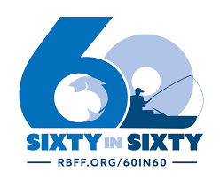
What we can do?
Notes:
Encourage everyone to go out and take 1 person in the woods hunting or take one person fishing.
Have to replace ourselves with diverse audience and we have to “practice what we preach”
NWTF Mentor Pledge, where you can pledge that you will be mentoring 1 new hunter
60 in 60- achieve 60 million fishing participants in 60 months by December 2021, resources for everyone “Take me Fishing”
Implementation of R3 Strategic Plan

