Slide 1
Lake Malone Vertical Control Monument Project
Commonwealth of Kentucky
Tourism, Arts and Heritage Cabinet
Department of Fish and Wildlife Resources
Engineering Division
Survey Branch
Kelly Carr, PLS

Slide 2
Project Purpose
To establish vertical monuments that will aid in the accurate placement of property lines adjacent to Lake Malone.

Slide 3
Present Situation
Existing surveys have used varied methods to establish property lines around the lake.
spillway elevation
water level on a given day
low water
high water
Original deed descriptions can be misunderstood when basic principles of surveying are not applied.
Adjoining owners may believe property rights extend to the water when in fact the rights that exists are for public use.
Deed distances are measured horizontal.
Every survey shall be made by horizontal measurement.
-Kentucky Revised Statute 73.070(1)
In plane surveying the reference base for field work and computations is assumed to be a flat horizontal surface.
-Wolf & Brinker, Elementary Surveying, Ninth Edition. New York: HarperCollins 1994

Slide 4
Present Conditions

Slide 5
Present Conditions

Slide 6
Mission
To provide the necessary vertical tie to the spillway elevation to locate property lines adjacent to Lake Malone.
Owners will need to retain the services of a local surveyor to utilize this information to locate property lines.
Availability of data may result in more economical survey costs for local owners.
Use of a common vertical datum will facilitate consistency between new surveys.
15 Monuments were placed for ease of use.
High visibility markers are placed at monuments to aid in recovery.
Any point on the Lake is less than 1 mile from a monument.
Monument data sheets are available to local Land Surveyors.
Monument data sheets are published on website for public use.
http://fw.ky.gov/

Slide 7
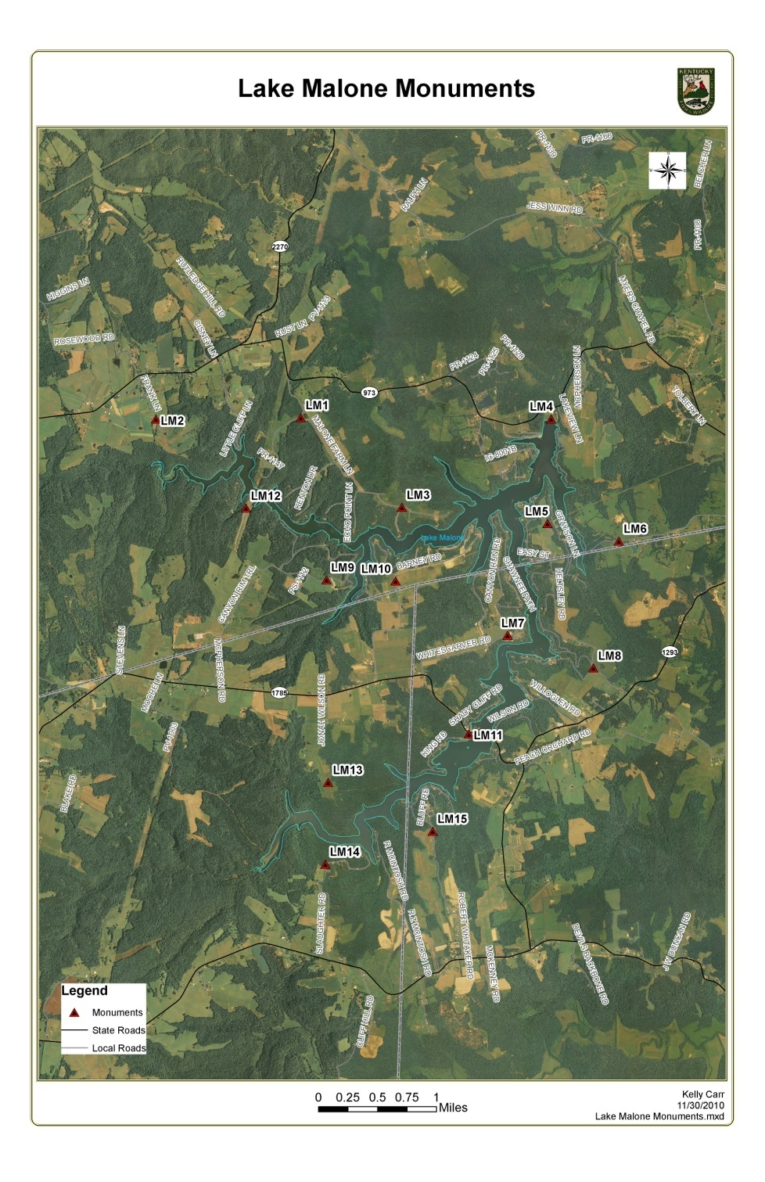
Project Map

Slide 8
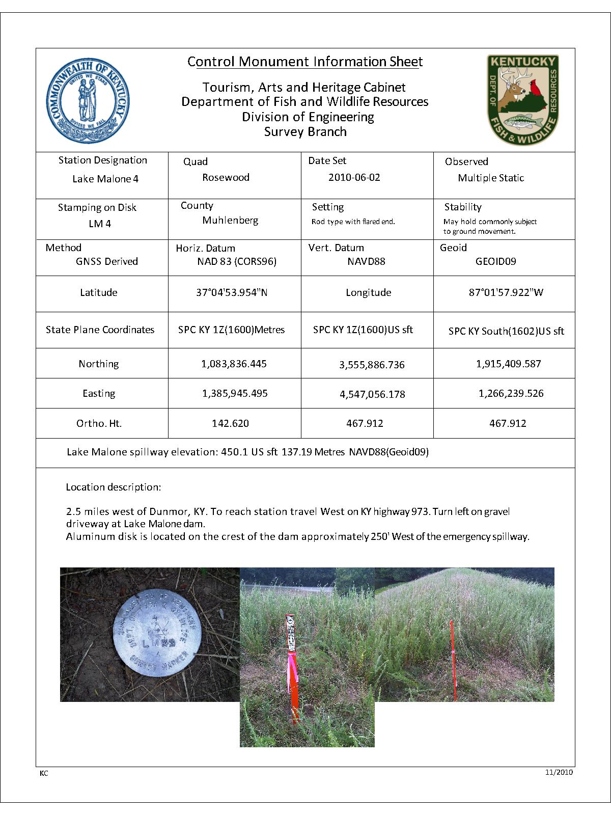
Monument
Data Sheet

